Slide 1
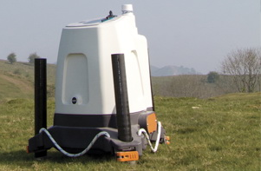

Slide 2
Outline
Introduction
Continuous-wave and pulsed Lidar
Vertical profilers
Advanced applications
Summary
Task

Slide 3
Introduction

Slide 4
Lidar: Light detection and ranging
Remote sensing device (like radar)
Several types and applications of Lidar:
Lidar speed guns used by the police
Elevation maps by airborne Lidar
Lidar for distance measurements in physics and astronomy
Lidar for wind energy
Wind Lidars are Doppler Lidars

Slide 5
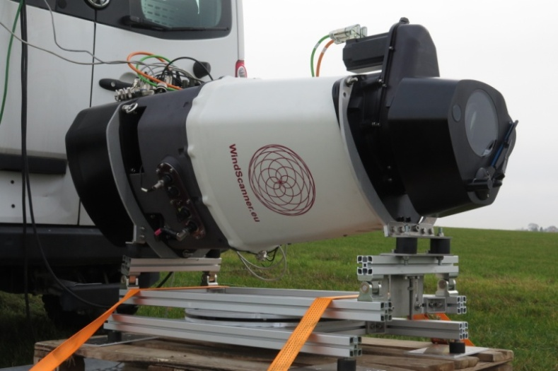
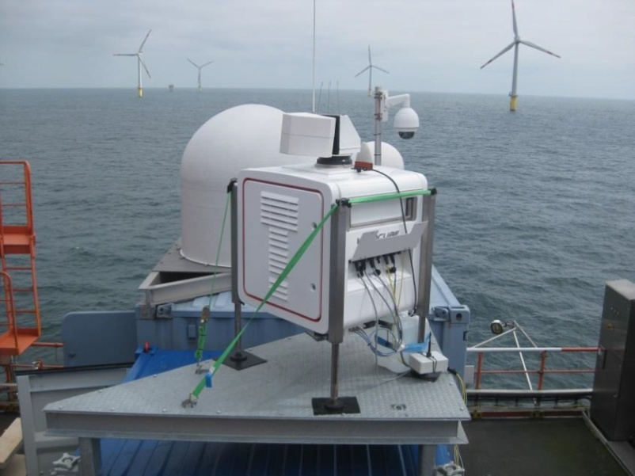
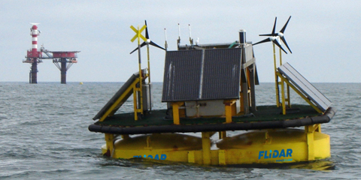
Lidar systems
[Fig.:DTU]
[Fig.:Zephir]
[Fig.:FLidar]
[Fig.:ForWind WeSYS]

Slide 6
Measurement of the radial wind speed
3. The radial component of the wind causes the Doppler shift
2. The laser beam is backscattered by the aerosol
Wind
Laser beam
Aerosol
1. The atmospheric aerosol is transported by the wind
4. The Lidar measures the Doppler shift
Lidar

Slide 7
Measurement of the radial wind speed
Wind, V
e_{LOS}
z, w, altitude
y, v, North
β elevation
azimuth α
x, u , East
$$V_{rad}=V⋅ e_{LOS}=\left[u v w\right]⋅[\cos\left(β\right)\sin\left(α\right) \cos\left(β\right)\cos\left(α\right) \sin\left(β\right)]$$

Slide 8
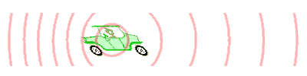

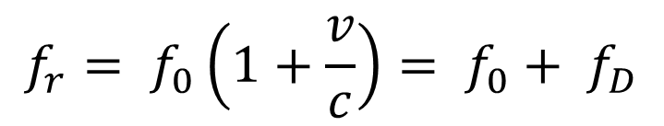
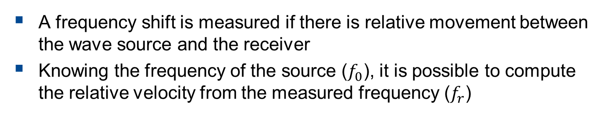
Doppler effect: principle
A frequency shift is measured if there is relative movement between the wave source and the receiver
Knowing the frequency of the source ($f_{0}$), it is possible to compute the relative velocity from the measured frequency ($f_{r}$)
$$f_{r}= f_{0}\left(1+\frac{v}{c}\right)= f_{0}+ f_{D}$$
Fig. Charly Whisky

Slide 9
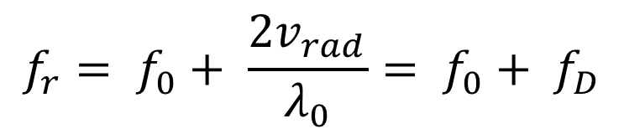
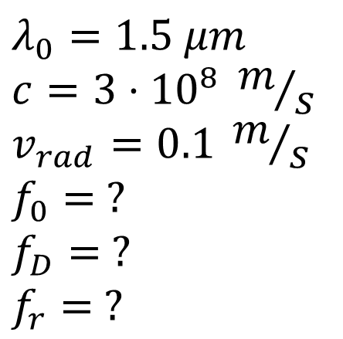
Doppler effect: exercise
$$λ_{0}=1.5 μm$$
$$c=3⋅{10}^{8} m/s$$
$$v_{rad}=0.1 m/s$$
$$f_{0}= ?$$
$$f_{D}= ?$$
$$f_{r}= ?$$
The aerosol does not emit spontaneously light
⇒ the Doppler effect applies on both ways to and from the particles
$$f_{r}= f_{0}+ \frac{2v_{rad}}{λ_{0}}= f_{0}+ f_{D}$$

Slide 10
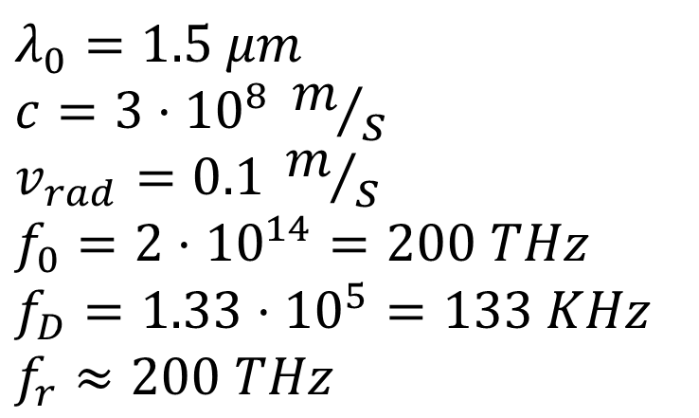
Doppler effect: exercise
$$λ_{0}=1.5 μm$$
$$c=3⋅{10}^{8} m/s$$
$$v_{rad}=0.1 m/s$$
$$f_{0}=2⋅{10}^{14}=200 THz$$
$$f_{D}=1.33⋅{10}^{5}=133 KHz$$
$$f_{r}≈200 THz$$
$$f_{r}= f_{0}+ \frac{2v_{rad}}{λ_{0}}= f_{0}+ f_{D}$$

Slide 11
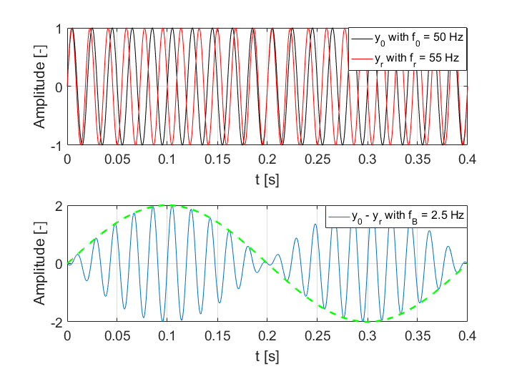
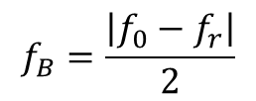
Heterodyne detection: the beat tone
$$f_{B}=\frac{\left|f_{0}−f_{r}\right|}{2}$$

Slide 12
Heterodyne detection: application
A reference beam and the received backscattered light are merged in an optical mixer
The interferece of the two waves generates a beating signal
A photo-diode samples the beating signal
Atmosphere
f₀ f + f_{D}
Transmitter/ Receiver
Laser
f₀
f₀ + f_{D}
Optical mixer
f_{D}
Photo-Diode
v_{rad}
f₀ : Laser frequency
f_{D} : Doppler frequency

Slide 13
Continuous-wave and pulsed Lidar

Slide 14
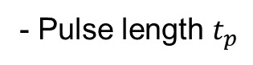
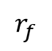
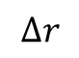
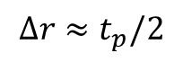
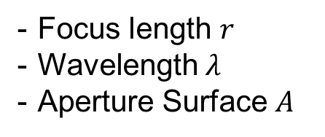
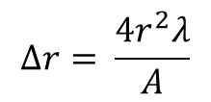
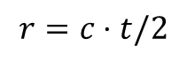
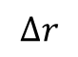
Laser source
Wind-lidar categories:
Continuous wave, cw → distance = focus point
Pulsed → distance = time of flight
$$r=c⋅t/2$$
$$r_{f}$$
$$Δr$$
$$Δr$$
Range up to a few hundred metres
High sampling rate
Range up to a few kilometres
Focus length $r$
Wavelength $λ$
Aperture Surface $A$
$$Δr= \frac{4r^{2}λ}{A}$$
$$Δr≈t_{p}/2$$
- Pulse length $t_{p}$

Slide 15
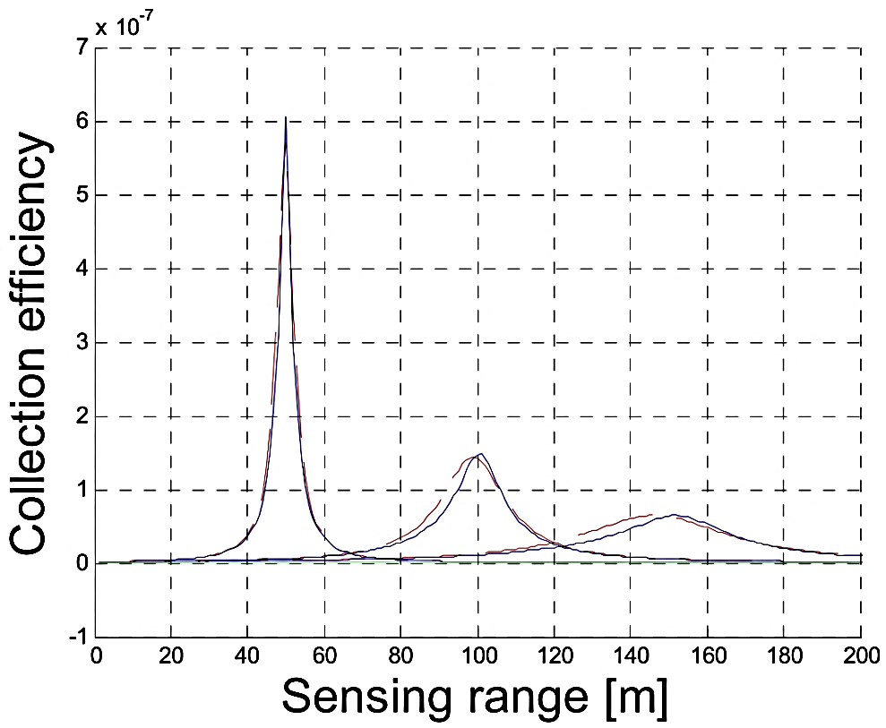
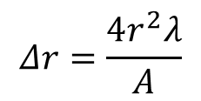
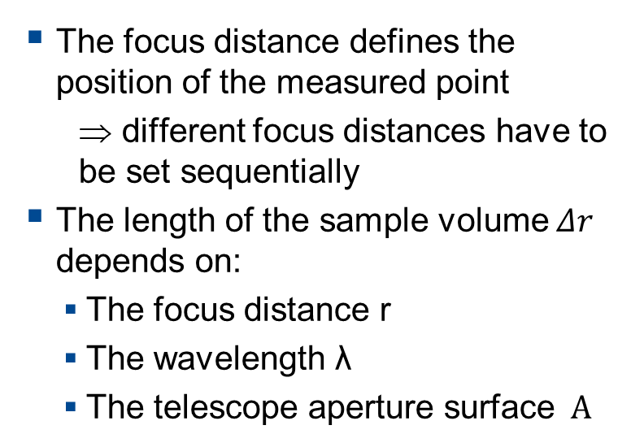
Continuous wave lidars (i)
The focus distance defines the position of the measured point
⇒ different focus distances have to be set sequentially
The length of the sample volume $Δr$ depends on:
The focus distance r
The wavelength λ
The telescope aperture surface $A$
Fig.: Lindelöw, 2007

Slide 16
Continuous wave lidars (ii)
Slide: M.Harris, Natural Power

Slide 17
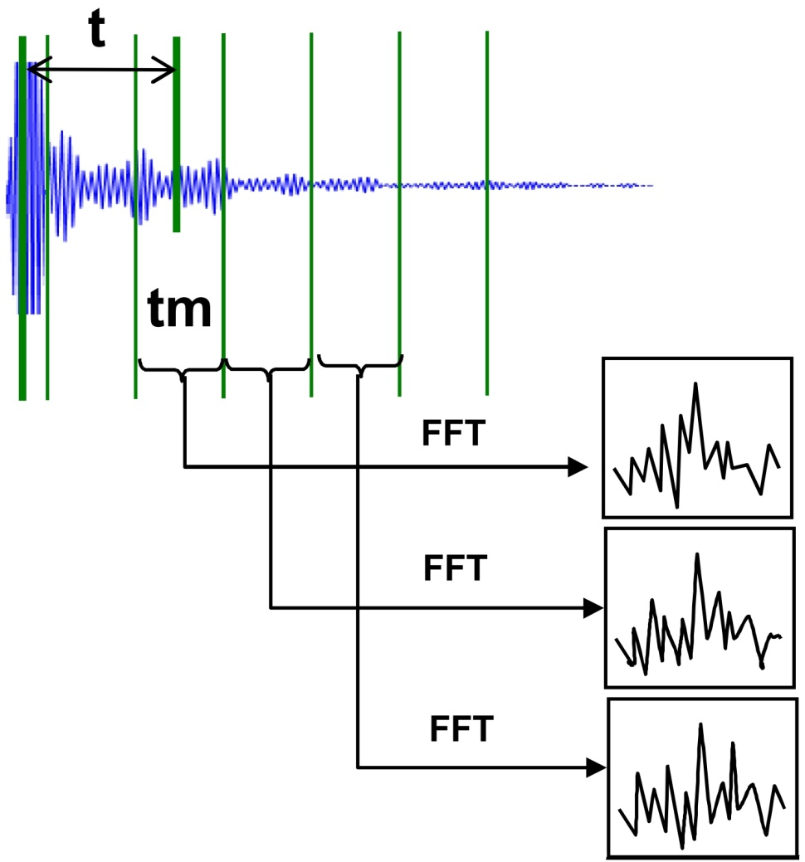
Pulsed lidars (i)
For each pulse the heterodyne signal is segmented
For each segment tm (range gate) the power spectrum is computed.
From the time t the distance of the measurement point is evaluated
For each range gate, the power spectrum is calculated
Noise is filtered out by averaging the spectrum of n laser pulses
The Doppler peaks are identified
Fig.: J.-P. Cariou, Leosphere.

Slide 18
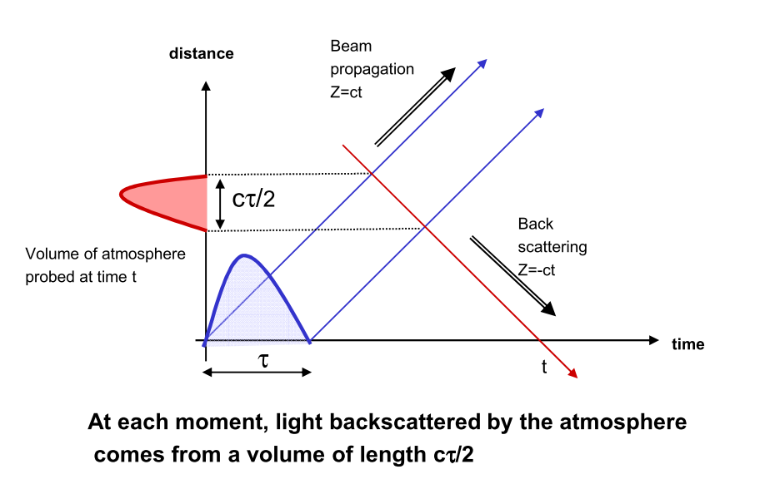
Pulsed lidars (ii)
Slide: J.-P. Cariou, Leosphere, mod.
Slide: J.-P. Cariou, Leosphere.

Slide 19
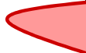
Pulsed lidars (ii)
Slide: J.-P. Cariou, Leosphere, mod.
tm
The weighting function is the convolution of the pulse and the range gate window
The weighting function is the same for all range gates
The probe volume is defined by the weighting function

Slide 20
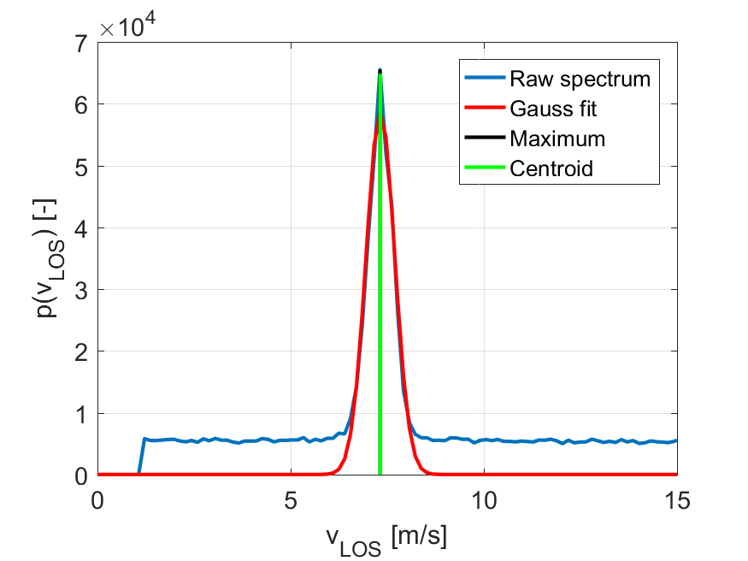
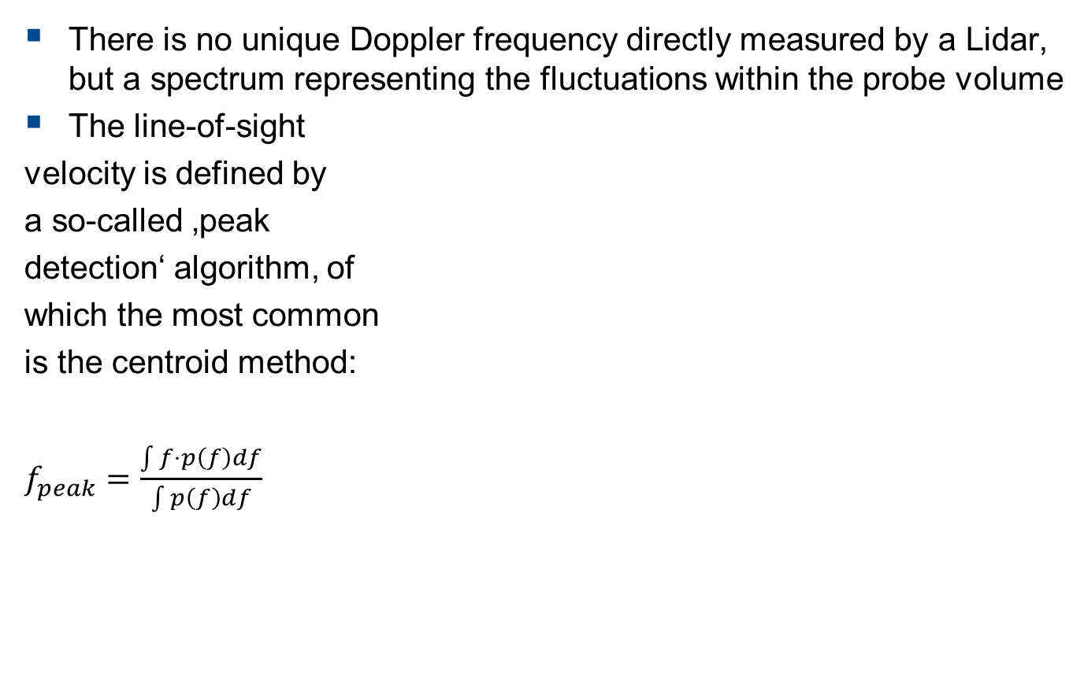
Peak detection in the spectra
There is no unique Doppler frequency directly measured by a Lidar, but a spectrum representing the fluctuations within the probe volume
The line-of-sight
velocity is defined by
a so-called ‚peak
detection‘ algorithm, of
which the most common
is the centroid method:
$f_{peak}=\frac{\int{f⋅p\left(f\right)df}}{\int{p\left(f\right)df}}$

Slide 21
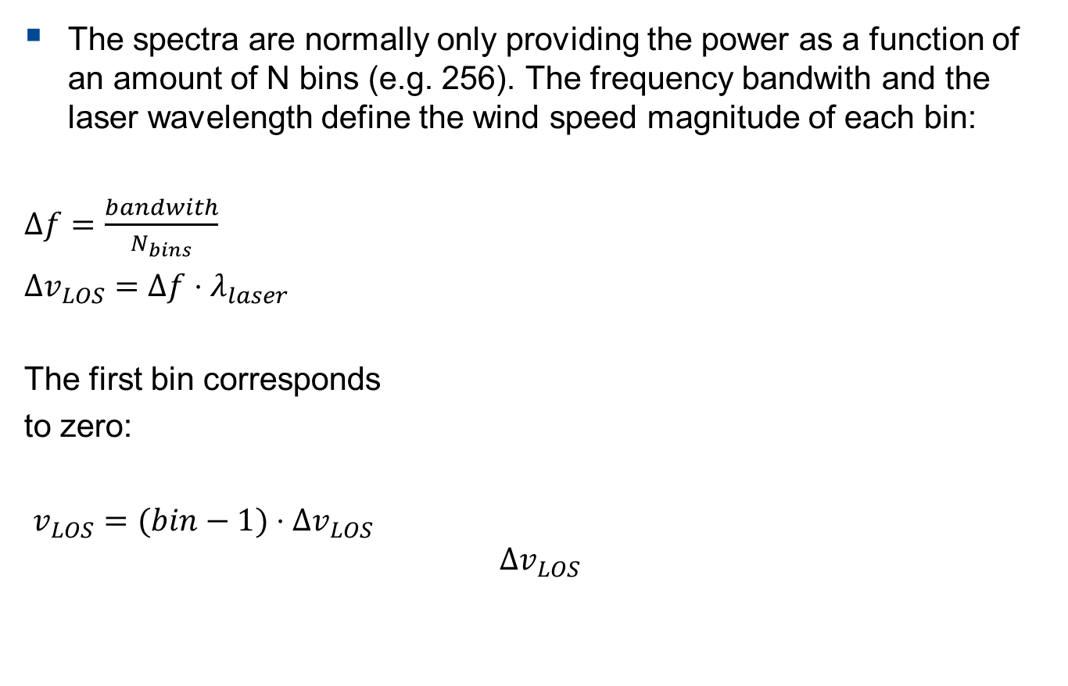
Peak detection in the spectra
The spectra are normally only providing the power as a function of an amount of N bins (e.g. 256). The frequency bandwith and the laser wavelength define the wind speed magnitude of each bin:
$Δf=\frac{bandwith}{N_{bins}}$
$Δv_{LOS}=Δf⋅λ_{laser}$
The first bin corresponds
to zero:
$v_{LOS}=(bin−1)⋅Δv_{LOS}$
$$Δv_{LOS}$$

Slide 22
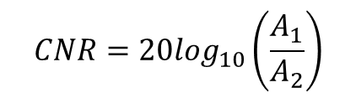
The Carrier-to-Noise-Ratio (CNR)
It is defined in decibel (dB)
Ratio between noise and signal power
It depends on the backscatter intensity
on the distance of the range gate
on the visibility
on the aerosol concentration
Increase with the number of averaged spectra
Data below a certain threshold should be discarded
A₁
Power spectrum
Power spectrum
A₂
frequency
frequency

Slide 23
Vertical profilers

Slide 24
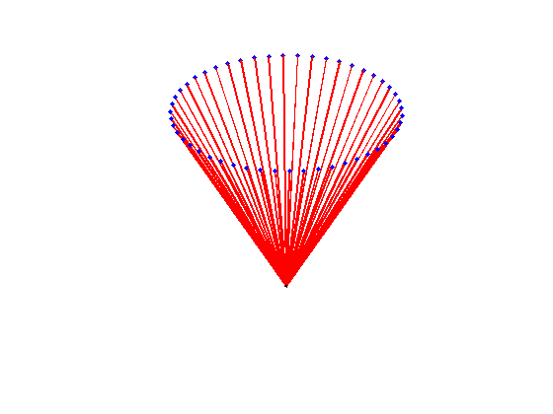
From radial wind to wind vector
Vertical profilers
One measurement = One radial wind speed
At least three measurements in three not linearly dependent directions are required
Standard approach of vertical profiler:
cw ⇒ Velocity Azimuth Dislplay (VAD): Radial wind speed at several points scanning a vertical cone (one height per scan)
Hypothesis: homogeneous wind field
VAD
* three or five directions are also used

Slide 25
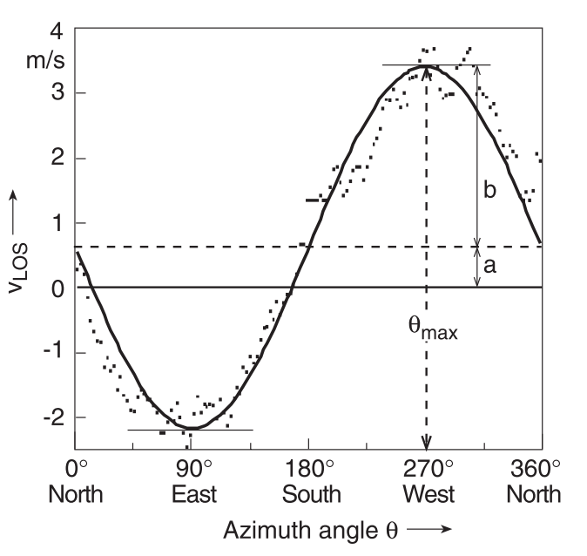
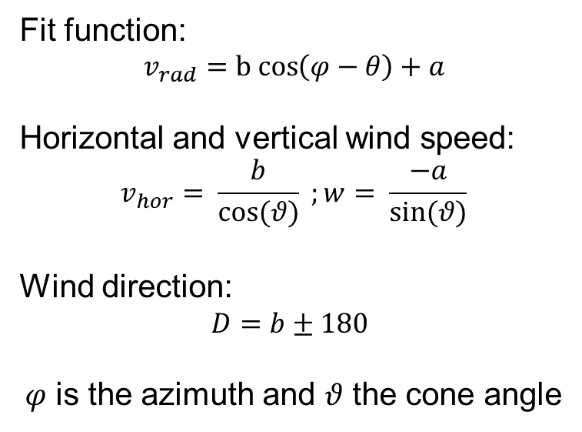
From radial wind to wind vector Velocity Azimuth Display (VAD, cw)
Radial wind speed commonly sampled at 50Hz
There is direction anbiguity (the cosinus is an even function)
New focus distance required to scan a different height
Fit function:
$$v_{rad}=b cos\left(φ−θ\right)+a$$
Horizontal and vertical wind speed:
$$v_{hor}= \frac{b}{\cos{(θ)}} ;w= \frac{−a}{sin⁡(θ)}$$
Wind direction:
$D=b±180$
$φ$ is the azimuth and $θ$ the cone angle
Fig.: Werner

Slide 26
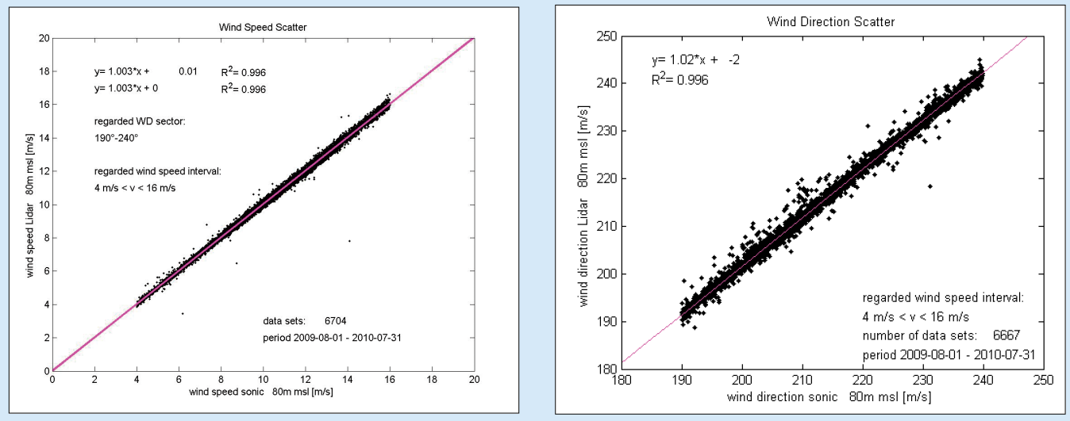
From radial wind to wind vector Comparison with standard anemometer (calibration)
10-min average of the horizontal wind direction and speed
Scatter plot and linear regression of standard anemometry and lidar statistics
10-min average fits well
For the standard deviation it is not so straight-forward...
Fig.: B. Canadillas.

Slide 27
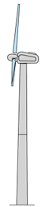
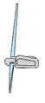
From radial wind to wind vector: Discrepancies with standard anemometer
Breakdown of the homogeneity model of the flow
complex terrain, wakes, shear, veer, turbulent structures
Atmospheric conditions
inhomogeneous scatter distribution, clouds, rain, veer
Accuracy of device components/installation
cone angle, sensing range, tilt mounting,
Accuracy/installation of standard anemometry
u
u

Slide 28
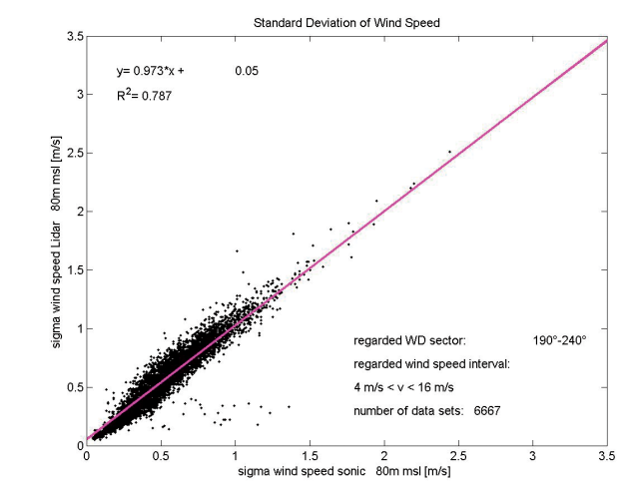
From radial wind to wind vector The standard deviation...
generally shows a larger scatter
sometimes has a positive offset
Why?
Fig.: B. Canadillas.

Slide 29
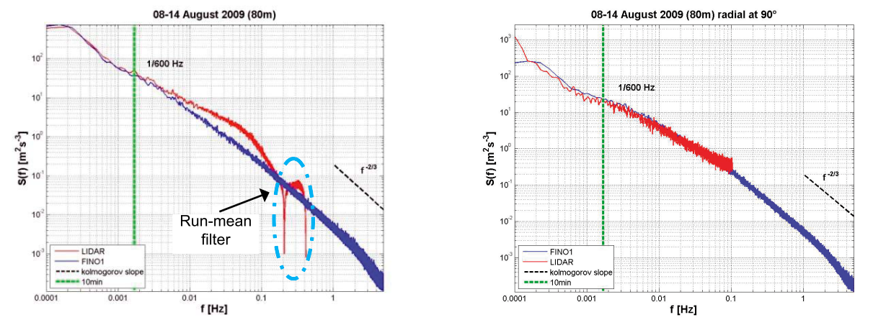
From radial wind to wind vector The standard deviation...
Evident signature of the running average.
Higher spectral density of the lidar in the freq. range below 1/10min for the hor. wind speed.
Comparable spectral densities of the radial wind speed
⇒ Effect of turbulent structures.
sensed only partially by the lidar beams.
Hor. wind speed
Radial wind speed
Fig.: B. Canadillas.

Slide 30
Advanced applications

Slide 31
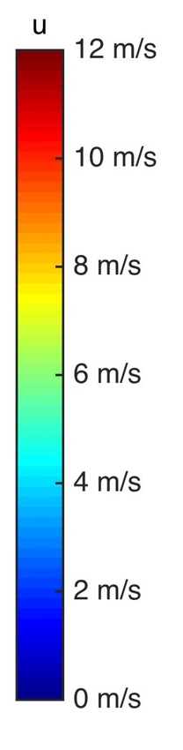
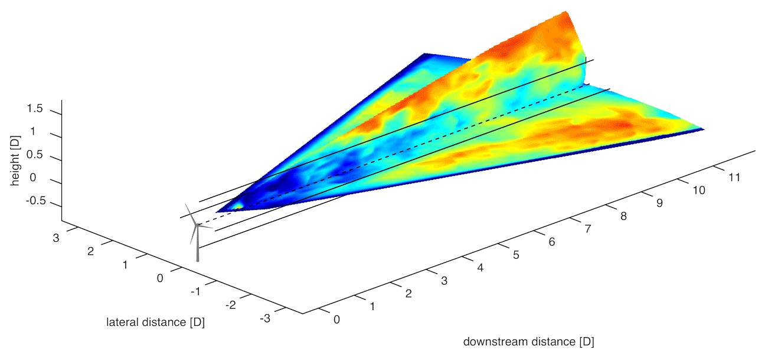
Lidars, not only profilers
Scanning Lidar
Wind field measurements
Flexible trajectories
Vortex detection
Hard targets, clouds, atmospheric boundary layer
RHI - Scan
PPI - Scan
Fig.: ForWind – Uni Oldenburg.

Slide 32
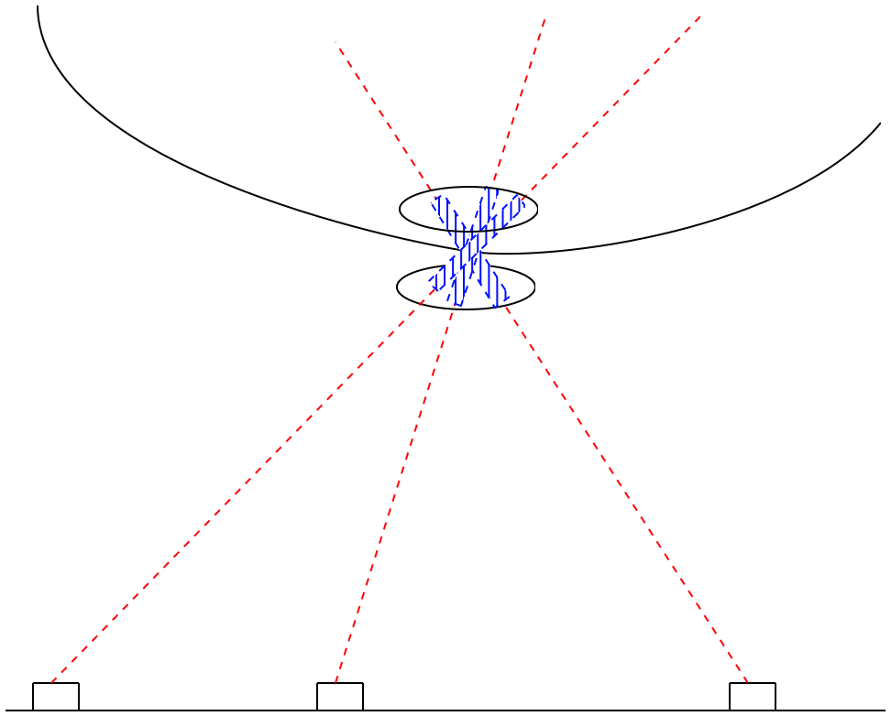
Lidars, not only profilers
Multi-Lidar
Retrieval of the 3D wind vector
Reduced probe volume
Higher sample rate
Three concurrent lidars:
V_{rad,1} = [u v w] · [cos(β₁)sin(α₁) cos(β₁)cos(α₁) sin(β₁) ]
V_{rad, 2} = [u v w] · [cos(β ₂)sin(α ₂) cos(β ₂)cos(α ₂) sin(β₂) ]
V_{rad, 3} = [u v w] · [cos(β ₃)sin(α ₃) cos(β ₃)cos(α ₃) sin(β₃) ]
Linear system in the form [A] · b = c
A meaningful solution exists for three linearly independent e_{LOS}
32

Slide 33
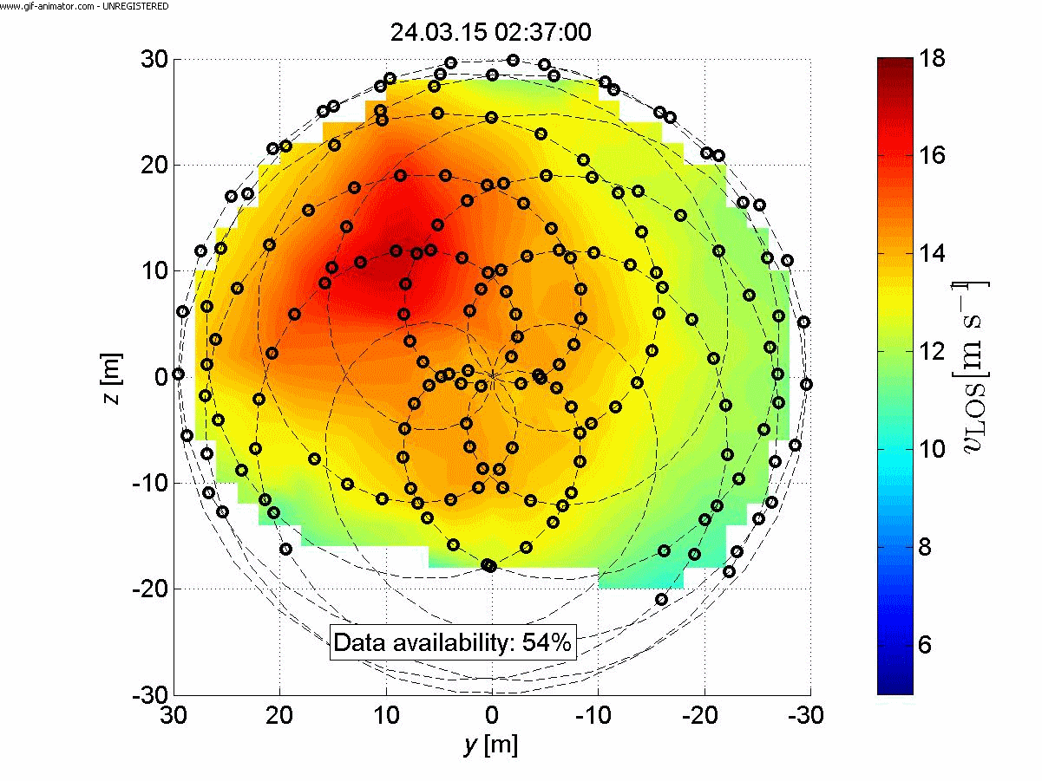
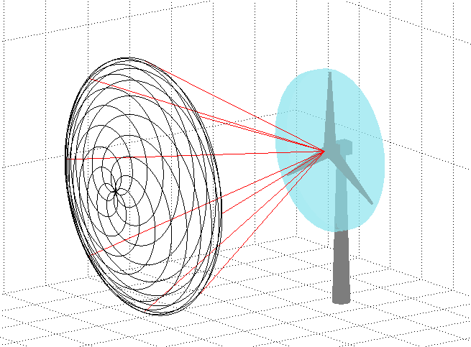
Lidars, not only profilers
2D SpinnerLidar
2D wind fields in the inflow of wind turbines
Feed-forward rotor control
Detection of incoming gust events

Slide 34
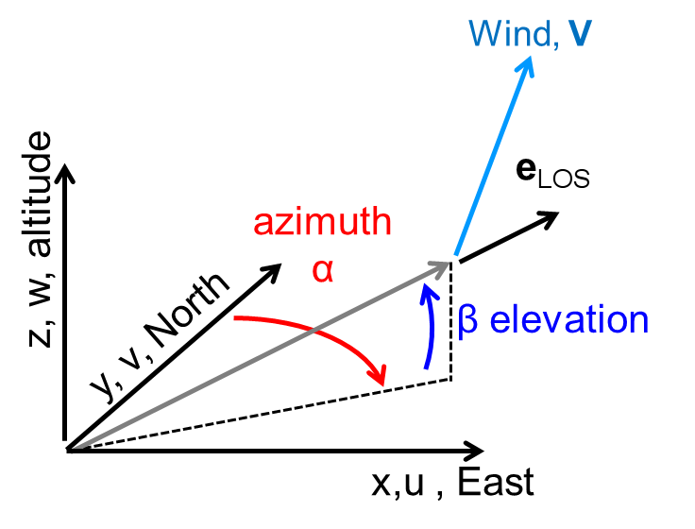

Lidars, not only profilers
Multi lidar
Single lidar:
V_{rad} = V · e_{LOS}
= [u v w] · [cos(β)sin(α) cos(β)cos(α) sin(β) ]
Three concurrent lidars:
V_{rad,1} = [u v w] · [cos(β₁)sin(α₁) cos(β₁)cos(α₁) sin(β₁) ]
V_{rad, 2} = [u v w] · [cos(β ₂)sin(α ₂) cos(β ₂)cos(α ₂) sin(β₂) ]
V_{rad, 3} = [u v w] · [cos(β ₃)sin(α ₃) cos(β ₃)cos(α ₃) sin(β₃) ]
Linear system in the form [A] · b = c
A meaningful solution exists for three linearly independent e_{LOS}
34

Slide 35
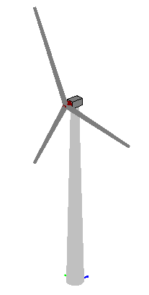
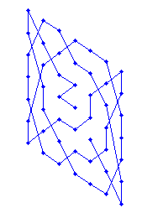
Lidars, not only profilers
Nacelle based lidars
Wind turbine control (pitch and yaw)
Power/loads assessment (particular advantages for offshore application)
Wake measurements
2 alternating beams (pulsed,cw)
Prism scanner, spinner based (pulsed,cw)
2 DOF scanner, (pulsed)

Slide 36
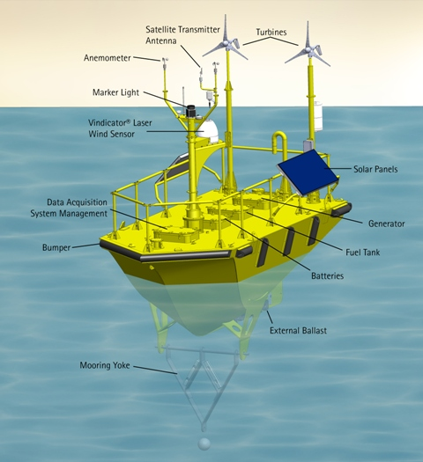
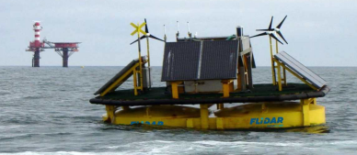
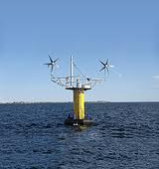
Lidars, not only onshore
Floating wind profilers
Easy deployable (compared to a mast)
Power supply issue (small wind turbines, photovoltaic panels, battery, generator)
Sea-state compensation (relative speed, beam inclination, wave height)
Fig.,AXYS, WindSentinel.
Fig.,Zephir LTD, SeaZephir©
Fig.3E, Flidar .

Slide 37
Summary

Slide 38
Summary
Wind Doppler lidars are remote sensor based on laser
The Doppler effect applies to the radial speed only
One measurement derives information from the light backscattered by the aerosol in the atmosphere
The radial wind speed represent a weighted average over the sample volume defined by the lidar charateristics
Continuous wave and pulsed lidars define the distance of measurement point differently
Different strategies to evaluate a wind vector (VAD, DBS, ...)
Wind profilers require homogeneity of the wind field
Attention must be paid to evaluate turbulence properties with lidars
Other application: scanner, nacelle base, multi lidar, floating devices

Slide 39
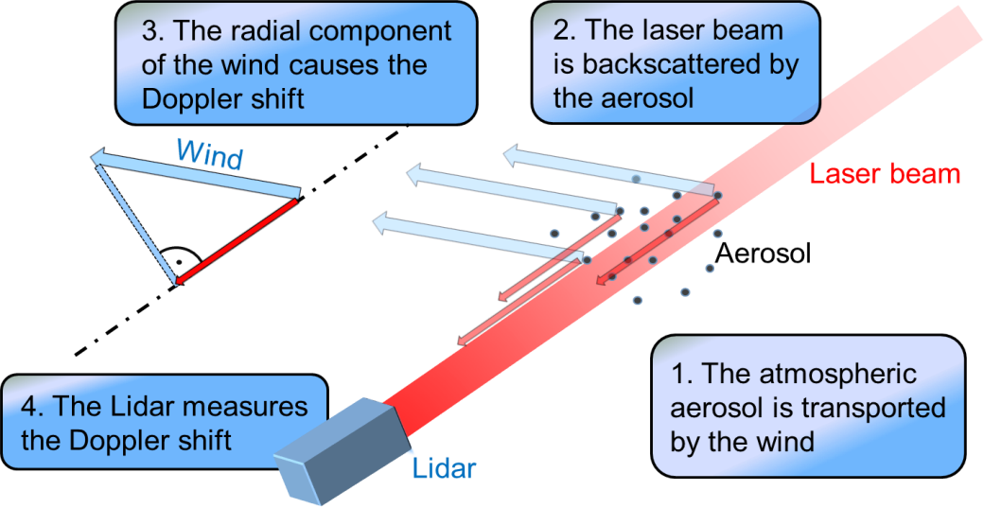

FFT analysis of
received signal
Division of signal in
range gates for pulsed
Lidar
Averaging over several
pulses and indentification
of Doppler Peak
Lidar make use of the Doppler Effect
The Doppler effect applies to the radial speed only
Continuous and pulsed Lidars define range differently
VAD wind profiler
Requires homogeneity
of the wind flow
Attention must be paid
to evaluate turbulence
properties with Lidars
Other applications for Lidar
RHI/PPI Scans
SpinnerLidar, Multi-Lidar

Slide 40
Tasks

Slide 41

Tasks
SpinnerLidar Spectral Analysis
Peak finding in raw spectra
Define the $v_{LOS}$ of each spectra and filter outliers
Plot the $v_{LOS}$ wind field
Comparison
Wind Lidar vertical profiler (pulsed system)
Meteorological met-mast anemometry
3D vector calculation
Triple-Lidar systems of WindScanners
Calculate [u v w] from three $v_{LOS}$ measurements
* The datasets are produced by means of lidar simulation in a wind field generated by a LES implementation

Slide 42


Task 1 Measurement description
42

Slide 43

Task 1 Measurement setup
AV04
Turbine closest to FINO1
Inflow measurements
1 Hz scans of wind fields with 312 Hz samping rate of points
Measurements at different distances
Not installed in spinner but on nacelle: BLADE interference
alpha ventus
AV04
43

Slide 44



Task 2 Measurement description
44

Slide 45
Task 2 Measurement setup
VAD
Pulsed system
0.4 s acc. time (2.5 Hz)
25°/s
Average over scanned sector (!)
Fino
10-min average wind speed
10-min average wind direction
VAD
45

Slide 46


Task 2
Hint cosine fitting matlab
Fit function:
$$v_{rad}=b cos\left(φ−θ\right)+a$$
Define function in Matlab
$$VADCos=@\left(param,φ\right) param\left(1\right)∗\cos\left(φ −param\left(2\right)\right)+param(3)$$
Solve function with lsqcurvefit in least sqared sense
$$fitparam=lsqcurvefit\left(VADCos,startvalues,φ,v_{LOS}\right)$$
Rember to define start values for each parameter
i.e. $startvalues=\left[2 10 1\right]$
46

Slide 47
Task 2 Measurement data
Lidar data
Files divided in folders by sensor’s ID
Files include 6 hrs of measurements
Files are identified by the time stamp of their first entry
Variables:
data, structures including
ts: time stamp (days, matlab format)
az_c, el: azimuth and elevation angles (degreee)
rg: range gates (m)
x,y,z: Cartesian coordinates (m)
rs: radial wind speed (m/s)
cnr: carrier to noise ratio (dB)
tstart: beginning of the10-min interval (days, matlab format)
47

Slide 48

Task 2 Measurement data
FINO1 data
One file for the whole period
Variables:
time: time stamp of the beginning of the 10-min interval (days, matlab format)
d40, d90: 10-min average wind direction at 40m and 90m [°]
v40, v100: 10-min average wind direction at 40m and 100m [m/s]
48

Slide 49
Task 2 Working steps
 | VAD | LOS | Met. mast data
Load data | ✓ | ✓ | ✓
Filter quality | consider only -20<CNR<-5 |  | N/A
10-min. subdivision | ✓ | ✓ | Already provided
Filter outlier (±3StdDev) | azimuth binning | ✓ | ✓
Identify range/height | ✓ | ✓ | ✓
Processing | Cosinus fit | N/A | Projection on LOS direction
Regression analysis | Metmast data | Pojection of metmast data | N/A

Slide 50



Task 3 Measurement setup
Multi-Lidar
Three short-range cw WindScanners
3D wind vector measurements at $h=90$ m
100 Hz samping rate
Location: Test field at DTU Risø Campus
50

Slide 51


Appendix VAD method for pulsed lidar (i)

Slide 52




Appendix VAD method for pulsed lidar (ii)
Function to fit:
Wind components
Hrz. wind speed
Wind direction
Vert. wind speed

